Slide 1
Pre-abilitazione motoria: razionale fisiopatologico e impatto clinico
Prof. Monica Nannipieri
Dir. Medicina dello Sport
Dip. Medicina Clinica e Sperimentale
AOUP
Università di Pisa

Slide 2
Main benefits of physical activity/exercise training in people with obesity
and mental health
Oppert JM, Reviews in Endocrine and Metabolic Disorders 2023

Slide 3
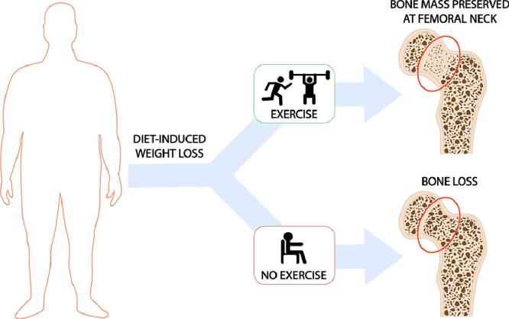
Main benefits of physical activity/exercise training in people with obesity
Weight Loss Intervention
Strategies to preserve lean mass during Weight Loss Intervention
SURGICAL OR
J Sport Health Sci, 2021
Legrand MA, Obesity, 2026

Slide 4

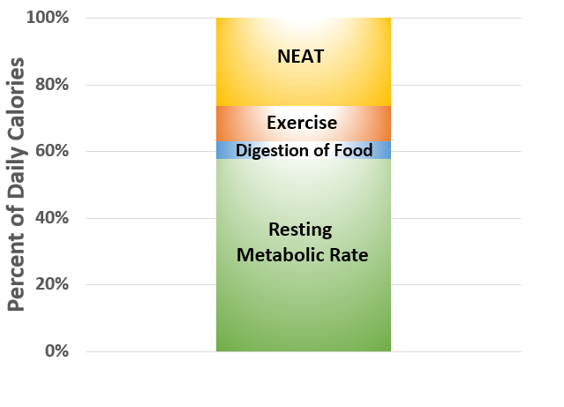

Slide 5
How physical activity contributes to body composition, components of fitness, and health within approaches targeting body weight regulation
Translational Journal of the American College of Sports Medicine 2024

Slide 6
What is already known about this subject?
Improving health-related quality of life (HRQoL), a major goal of bariatric
surgery, may be undermined by low physical activity (PA).
Previous observational studies have shown that low PA in bariatric surgery patients is associated with worse HRQoL preoperatively and smaller HRQoL improvements postoperatively.

Slide 7
Obesity (Silver Spring). 2015 March ; 23(3): 536–542. doi:10.1002/oby.20988.
Exercise improves quality of life in bariatric surgery candidates: Results from the Bari-Active trial
Dale S. Bond
Comparison of baseline to post-intervention changes in SF-36 scores between participants randomized to the Physical Activity Intervention (PAI) and Standard Pre-Surgical Care Control (SC) conditions
PF = Physical Function, RP = Role- physical, BP = Bodily Pain, GH = General Health, VT = Vitality, SF = Social Functioning, RE = Role-Emotional, MH = Mental Health, PCS = Physical Component Summary, MCS = Mental Component Summary

Slide 8
Conceptual framework of perioperative exercise interventions in bariatric surgery.
Blue line: patients who receive preoperative and postoperative exercise training.
Orange line: patients who only receive preoperative exercise training.
Purple line: patients who do not receive any perioperative exercise intervention.
We can state that perioperative exercise programs in bariatric surgery might have beneficial effects on weight loss parameters, physical activity measurements and risk factors for cardiovascular diseases. However, the heterogeneity of exercise programs makes comparisons difficult and according to several studies reviewed in this paper it is not evident as to what the optimal exercise programs should be and what the timing should be around bariatric surgery.

Slide 10
Conclusion
Pilot trial showed that adding pre-operative aerobic exercise to standard medical care decreased the length of hospital stay in patients receiving bariatric surgery compared to standard medical care alone. The reduction in length of hospital stay with EX+SC may be mediated by fitness-related adaptations including the reduction in adipose tissue derived hormones, preservation of lean mass, and enhanced metabolic flexibility. This study highlights the potential benefit of adding aerobic exercise to SC for improving metabolic health in the bariatric patient.
Conclusion
Preoperative EX + SC did not elicit greater overall improvements in cardiometabolic health and QoL than SC alone in the 30-day postoperative period, despite some sustained benefit in blood pressure, resting heart rate, HMW adiponectin to total adiponectin as well as leptin ratio.

Slide 11
Conclusions
Exercise program that combines endurance and resistance training and progressed from low to high intensities in patients who are awaiting BS:
reduction in weight,
maintaining the FFM, and without significant reductions of basal metabolic rate.
improvement of cardiorespiratory fitness
decrease in the visceral fat, waist circumference, waist-to-height ratio,
cardiometabolic risk factors.
Second, several studies show the importance of prehabilitation before major surgery to reduce postoperative complications and reach a faster postoperative recovery

Slide 12
Effect of physical activity before and after bariatric surgery
Niezgoda N, METABOLIC SYNDROME AND RELATED DISORDERS 2025

Slide 13
BARI-Prehab study design.

Slide 14
Bryan C. Jiang, Diabetes 2025

Slide 15
Mixed comparison of different exercise interventions on physical functioning in adult patients with morbid obesity following bariatric surgery: a systematic review and network meta-analysis
Front. Endocrinol. 15:1465718, 2024.
Conclusion
Telehealth core exercises are the most effective intervention for improving PF in OPBS. In terms of BMI reduction, the combination of nutritional behavior modifications, structured exercise programs, and increased protein intake yields the best results. For DBP reduction, a blend of aerobic exercise, strength training, and flexibility exercises proves most beneficial. Conversely, SBP is more effectively managed through personalized exercise prescriptions.

Slide 17

NEAT (Non-exercise activity Thermogenesis)

Slide 18
Expert-based physical activity guidelines for metabolic and bariatric surgery patients: a systematic review of randomized controlled trials
12 PA recommendations:
Begin PA intervention pre-MBS;
Unless contraindicated, walk short distances the day of the surgery;
Progressively increase movement through activities of daily living during the first month postoperatively;
Avoid prolonged sitting and adopt lifestyle routines that decrease sedentary time;
Slowly progress to 150-300 minutes of accumulated moderate-intensity cardiovascular exercise/week;
In addition to walking, gradually increase structured PA through a variety of activities;
Delay water exercise until surgical wounds have healed, around 4 weeks postoperatively;
Begin full body resistance training (RT) 4-6 weeks post-MBS on 2 noncontinuous d/wk;
Delay high-intensity PA and abdominal exercises for 8-12 weeks;
Have periodic assessments of strength and cardiovascular fitness to evaluate progress;
Continue long-term monitoring with exercise professionals in the context of health;
Consult with a registered dietitian to optimize nutrition alongside changes in PA.
Melissa Fernández-Alonso Surg Obes Relat Dis 2025

Slide 20
Conclusions
Consensus on exercise reporting template (CERT)
Obesity Reviews, 2025
PA interventions should adopt a training mode that combines RT with AE, clearly specify training equipment and locations, and provide supervision, motivational strategies, replicable exercise guidance, and training adherence evaluations to enhance the long-term improvement of PA levels in post-bariatric patients.

Slide 21
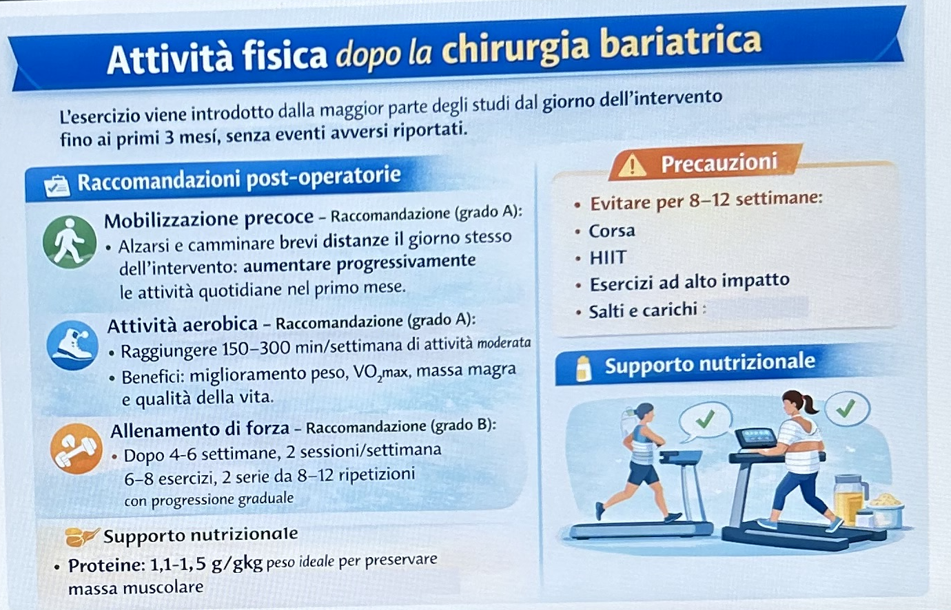

Slide 22
